Slide 1
Willey House Central Park
Funded in part by grants from the New Hampshire State Arts Council, Lamprey River Advisory Committee (pending) and the Town of Newmarket

Slide 2
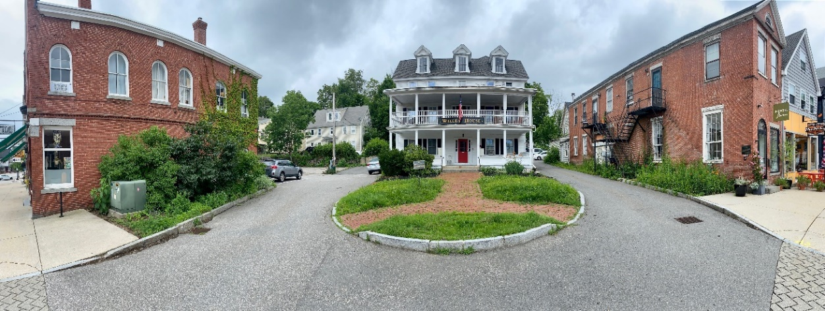
Project Overview
The project is located in the green space in front of the Willey House, originally called Rundlett Tavern, built in 1822.
The land in front of the Willey House is being donated to the town by the owner for public use.
The park will be located between the 1894 Durgin Block Building and the Edwin Smith Building.

Slide 3
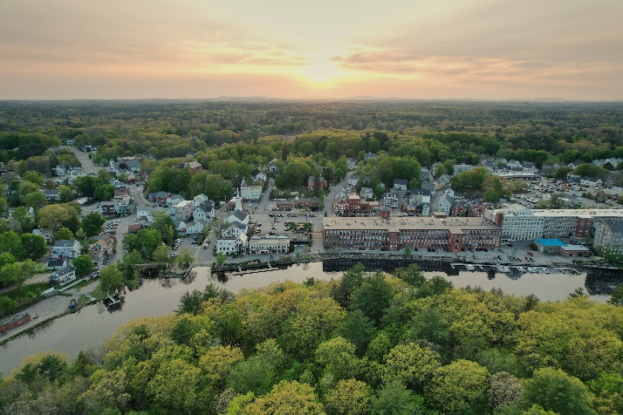
Project Goals
Enhance downtown Newmarket with another pocket park for community gathering & enrichment
Expand town art installations to include permanent sculpture using historic implements to artistically represent “river’s edge”
Educate public on the river that runs through Newmarket including its impact on life today and in the past
Create awareness of water conservation & area wildlife preservation through art creation & installation
Engage community in creation of art
Build awareness and appreciation for the
treasures of the Lamprey River

Slide 4
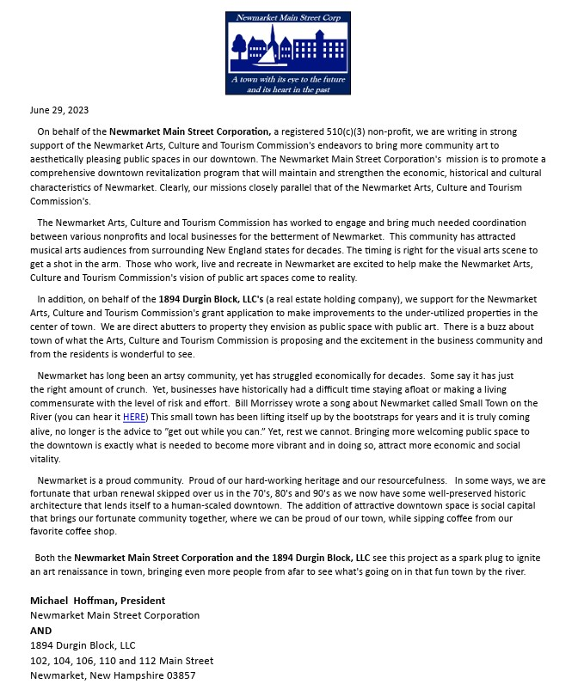
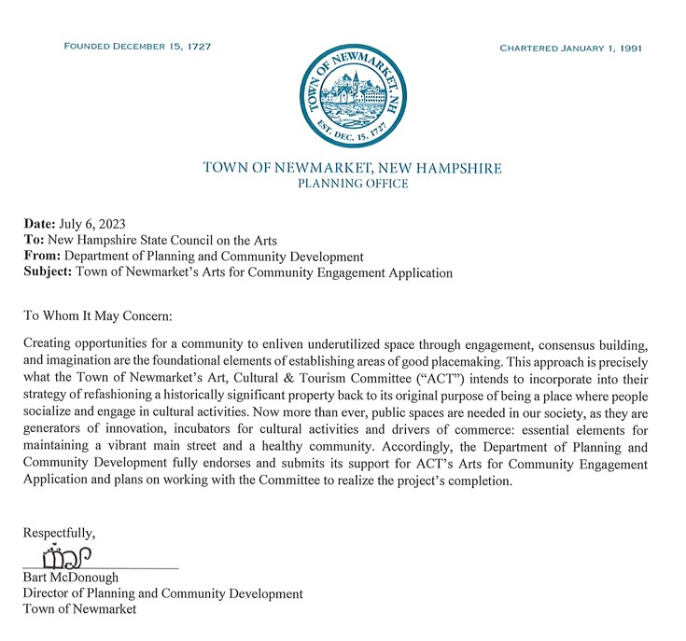
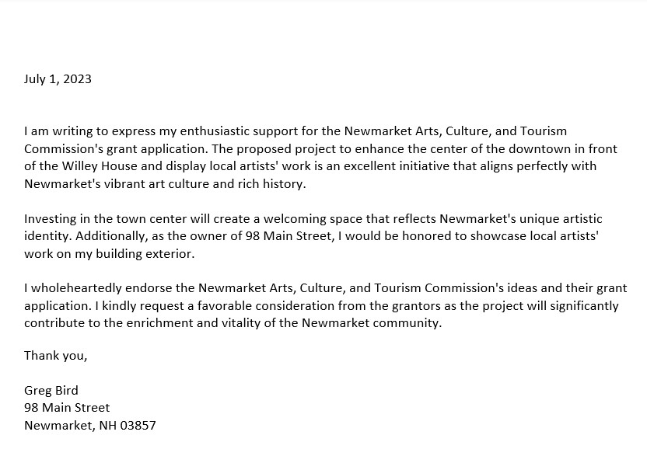
Community Support
Letters Received from:
Town Planning Director
Abutting Property Owners
Historical Society President
Main Street Corporation

Slide 5
Project Components – The Mural
A Welcome to Newmarket mural on the exterior of the 1894 Durgin Block Building will feature a collage of photographs taken by Newmarket residents.
The mural will be digitally printed and installed onto the bricked exterior.
Newmarket sits at the Lamprey river’s edge, which is the largest contributor of fresh water to the Great Bay Estuary and is a nationally protected, wild and scenic river. The river provides significant ecological, historic, recreational, wildlife, and community resources. The mural design will represent these elements.
Artist’s rendering of mural prototype

Slide 6
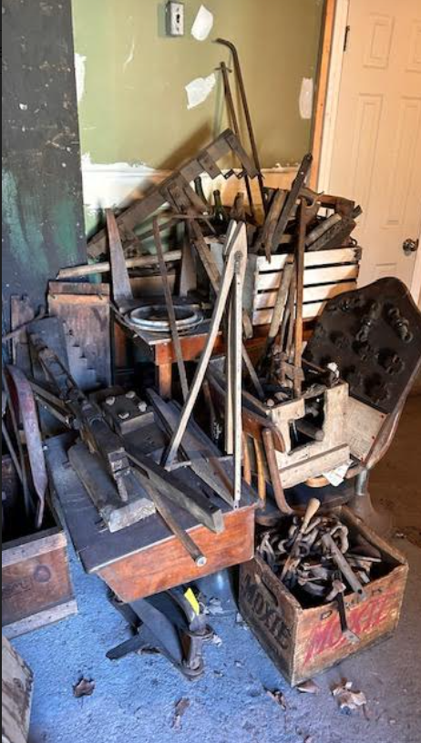
Project Components – Sculpture & Educational Display
Sculpture using farming and architectural implements donated by Historical Society
Educational displays regarding the river’s cultural impact, local wildlife preservation and water conservation housed in a mini art gallery
Public seating and gathering space representing water influenced creatures and activities

Slide 7
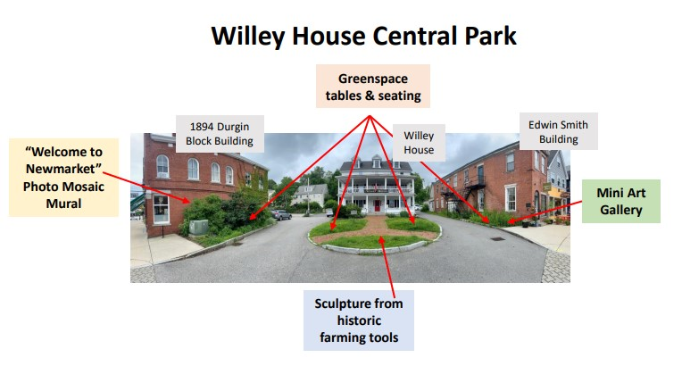
Proposed Park Design

Slide 8
Project Timeline
February 26 Request for Proposals (RFP) for mural design & sculpture
March 15 Install “Coming Soon Willey House Main Street Pocket Park” Sign
May 1 RFP Submissions Due
May 15 Finalist Design Presentations
June 1 Selection of Design Contest Winners
August 8 Submission Deadline for photos from Newmarket Residents
Sept 9 Final design files & sculpture due
Sept 9-23 Park landscaping and seating installation
Sept 15-27 Park Art Installation
Sept. 28 Park Unveiling

Slide 9
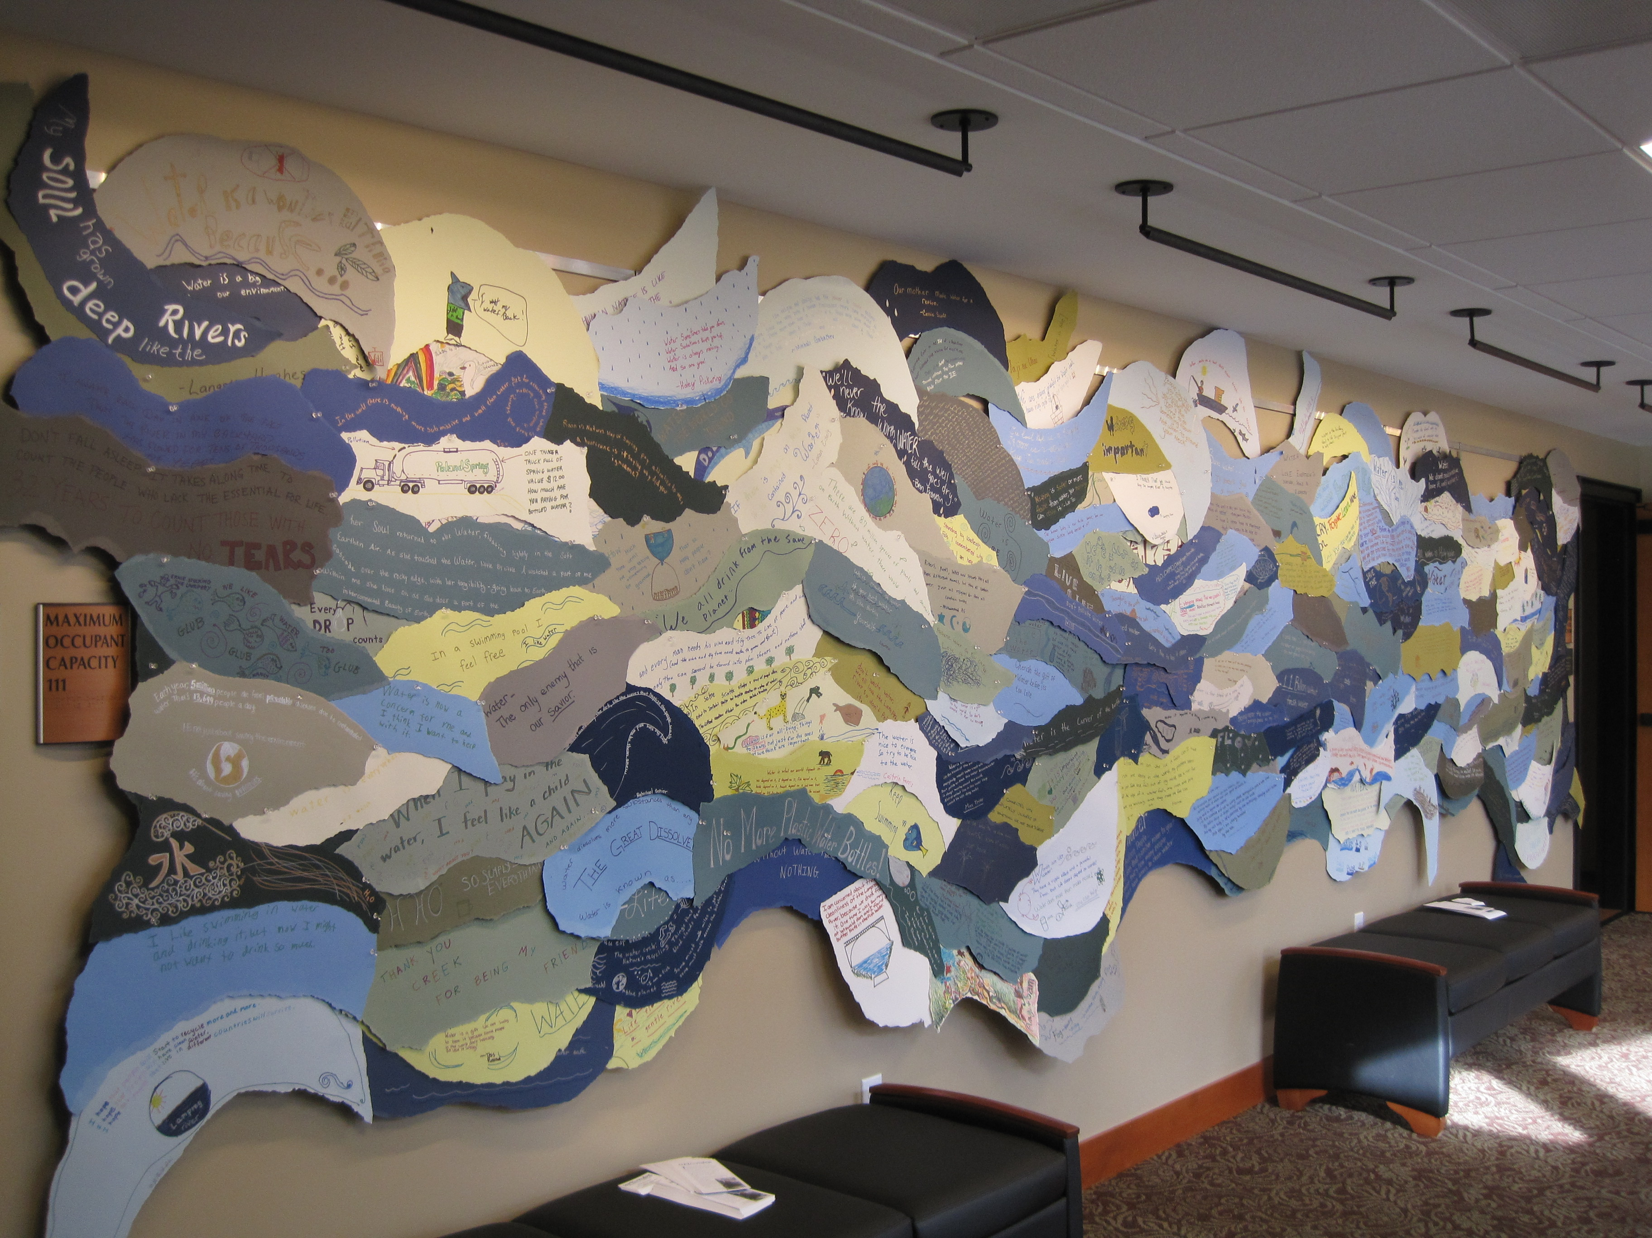
Community Engagement
APRIL Photography Education Series – workshops on taking
wildlife photographs with various camera types
MAY Herring Aid Event - celebration of the annual run of river herring that have
returned from life at sea to spawn in the freshwater of the river
JUNE Historic Photography Scavenger Hunt – in collaboration with the Newmarket Historical Society
JULY Life is an Adventure on the River - education series about river, wildlife &
conservation, resulting in a temporary community art installation at library
AUG Downtown Ice Cream Social Event – partnering with the Main Street
Corporation & Newmarket Business Association
SEPT “Why We LOVE Newmarket at the River’s Edge” Sidewalk Photo Exhibit

