Slide 1
MS4 Stormwater Management Program Newmarket, New Hampshire
June 26, 2019

Slide 2
Agenda
New Hampshire Small MS4 General Permit
Stormwater Management Program (SWMP)
Public Education and Outreach
Opportunities for Public Involvement

Slide 3
Discussion points
What is MS4?
Municipal Separate Storm Sewer System
2. What is Required?
Regulatory Compliance of Stormwater Discharges from MS4 to Waters of the United States

Slide 4
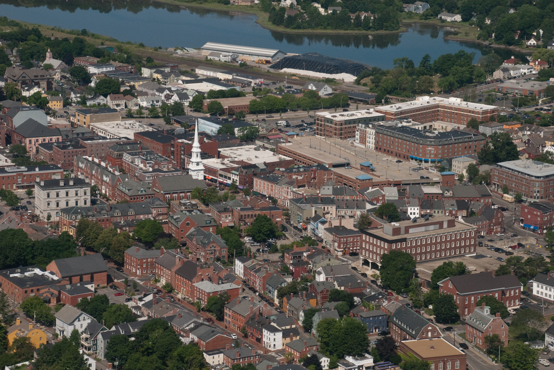
MS4 Communities
Basis and Definition
Cities and Towns
Proximity to Urban Center
Population Threshold – 50,000 people
Density Criteria – 1,000 per square mile
MUNICIPAL SEPARATE STORM SEWER SYSTEM
Notes:
Acronym for MS4

Slide 5
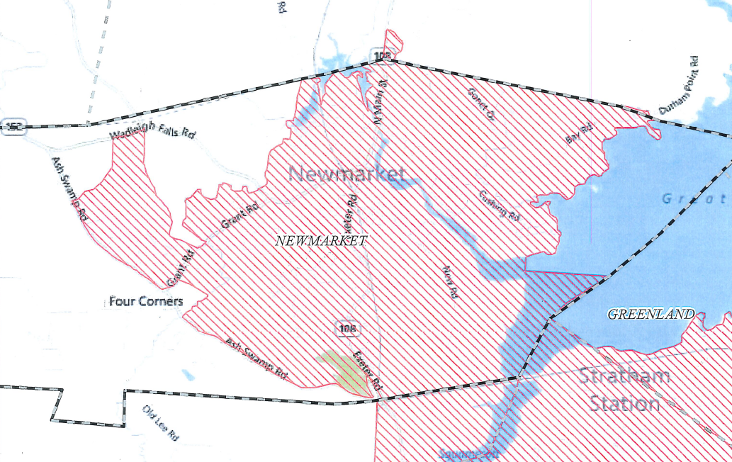
Newmarket MS4 Area

Slide 6
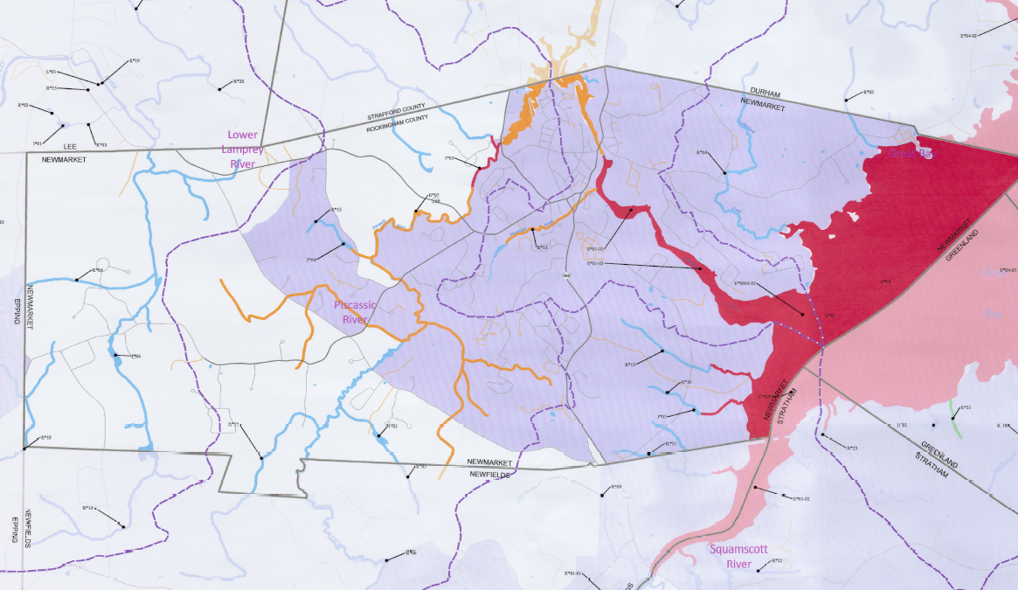
Newmarket Impaired Waters (NHDES 303d)

Slide 7
MS4 Permit Requirements
Notice of Intent (NOI) – Submitted October 1, 2018
EPA Authorization to Discharge – Received May 14, 2019
Stormwater Management Plan (SWMP)
Written Document to Describe Compliance Activities
Six Minimum Control Measures
Performance/Status Evaluation
Annual EPA Reporting

Slide 8
Minimum Control Measures
Ms4 Permit Requirements
Public Education & Outreach
Public Involvement & Participation
Illicit Discharge Detection & Elimination Program
Construction Runoff Control
Post-Construction Stormwater Management
Pollution Prevention for Municipal Operations

Slide 9
Public Education and Outreach
Targeted Messaging for Audience and Regulated Impairments
Four Target Audiences

Slide 10
Public Involvement
Public Review of SWMP
https://www.newmarketnh.gov/
Other Opportunities:
Adopt-a-Road Program
Cleanups – Roadside / General
Cleanups – Shoreline / Waterbody
Yard Waste – Drop off at Transfer Station

Slide 11
Q&A

