Slide 1
Newmarket’s
Capital Improvement Program (CIP)
Planning for Newmarket’s
Infrastructure

Slide 2
Introduction
What is a Capital Improvements Program?
What are the benefits?
What is the legal framework?
What is a capital project vs capital equipment?
What is the CIP Process?
Relationship with the Master Plan?

Slide 3
Capital Improvement Program (CIP)
The CIP is:
  a long-range planning document
  outlines anticipated expenditures for capital projects and equipment over a period of at least six (6) years

Slide 4
Capital Improvement Program (CIP)
  implements the community’s long-term planning goals with specific facility improvements, projects and programs
  is aimed at increasing the capacity of the town’s infrastructure to accommodate future growth and development

Slide 5
THE CAPITAL IMPROVEMENT PROGRAM (CIP)
Links local capital investments in infrastructure with land use planning and economic development
Infrastructure
Economic
Development
Land Use

Slide 6
A CIP program offers numerous benefits to the community
Benefits of the CIP
Preserves public health, safety and welfare | √
Anticipates demands of growth | √
Improves communications and coordination between departments | √
Avoids undue property tax increases | √
Supports economic development | √
Provides a foundation for growth management and impact fees | √

Slide 7
Legal Framework

Slide 8
RSA 674:5 Capital Improvement Program
Municipalities that have adopted a Master Plan are authorized to prepare a capital improvements plan with projects over a period of at least six (6) years.

Slide 9
RSA 674:6 Purpose and Description
  The CIP is:
  based on information submitted by departments and agencies of the municipality.
  takes into account public facility needs indicated by the Master Plan.
  classifies projects according to urgency and recommends a time sequence for implementation.

Slide 10
Prioritization of CIP Projects
Urgent - Class I
Necessary - Class II
Desireable - Class III
Deferrable - Class IV
-
Exploratory - Class V
Inconsistent - Class VI

Slide 11
RSA 674: 7: Preparation of the CIP
  strives for an annual level of capital expenditures that provides an affordable level of local tax expenditures to keep the tax rate relatively stabile
  requires a review the Capital Improvements Plan in relation to the goals and recommendations of the Town’s Master Plan

Slide 12
The CIP is part of the Town’s Budget Process
Town Administrator
Annual Town Meeting
Town Council/Budget Committee

Slide 13
RSA 674:8 Consideration by Town Council and Budget Committee
The CIP committee submits its recommendations for current year to the Town Council and the Budget Committee as part of the annual budget process.
The CIP is advisory.

Slide 14
RSA 674: 21 Impact Fees
In order for a municipality to adopt an impact fee ordinance, it must have enacted a CIP pursuant to RSA 674:5-7
are charged to recover the costs of capital improvements that are necessitated by new development
Newmarket charges impact fees for recreation, public school and water and sewer facilities.

Slide 15
Newmarket Town Charter
Establishes the Capital Improvement Program (CIP) Committee
    Town Council (Regular and Alternate)
    Planning Board (Regular and Alternate)
    Budget Committee (Regular and Alternate)
    School Board (Regular and Alternative)
    Two ‘at-large” members
Charges it with preparing the CIP
Grants them all powers under NH RSA 674:5

Slide 16
Two Types of CIP Requests
Capital Equipment:
Capital Equipment is defined as the purchase of a tangible item that is non-reoccurring; has a useful life of more than three (3) years; and an aggregate cost of at least $10,000.
Capital Improvement Project:
Capital Improvement Project is defined as a project undertaken to enhance the infrastructure and public facilities of Newmarket. It has a useful life of more than 10 years and costs at least $50,000.

Slide 17
Examples of Capital Improvement Projects
Upgrading Wastewater Treatment Plant
Acquisition of Well Sites
Reconstruction of Roadways
Upgrade Storm Water System
ADA Accessibility Improvements to Town and School Facilities
Engineering Studies, Master Plans, Conceptual Design, and Cost Estimates

Slide 18
Examples of Capital Equipment
  Replacement of Police Vehicles
  Purchase of Fire Equipment and Protective Gear
  Dispatch equipment and radios
  Playground equipment
  Public Works equipment – dump trucks, snow plows, sweepers and vacumn trucks

Slide 19
Relationship of the CIP to Master Plan
The Master Plan represents the collective vision that residents have for Newmarket as articulated through public meetings and comments solicited through the planning process.
The goals and recommendations of the Master Plan are reflected in a Vision Statement

Slide 20
Newmarket Master Plan | 2018/2019 CIP Projects
Veterans Memorial Trust Maintain a friendly small town atmosphere through a sense of community and encourage strong involvement of Newmarket residents in town projects and committees through volunteerism. | Continued capital reserve funding to the Newmarket Veterans Memorial Trust to fund the development of a new memorial to honor our war veterans
Fire Maintain a high level of service for the protection/safety of residents, as well as public and private property. | Continued capital reserve funding for fire safety equipment and continuation of vehicle replacement program.
Police Maintain a high level of service for the protection/safety of residents, as well as public and private property. | Continued capital reserve funding for equipment and vehicle replacement

Slide 21
Newmarket Master Plan | 2018/2019 CIP Projects
Recreation Provide quality, recreation opportunities for the citizens of Newmarket by improving the Town’s recreational facilities. | Continue capital reserve funding for recreation department for upgrading and adding new facilities
Water Continue efforts to identify and secure a safe, reliable, source of ground water to provide for the Town’s future needs for a drinking water supply and adequate flows for fire protection. | Continue capital reserve funding associated with well development, and infrastructure improvements.
Wastewater Upgrade the hydraulic and treatment capacity of waste water treatment facility and eliminate illicit storm drains in the wastewater system. | Continued funding of capital reserve fund for study, equipment replacement, and plans to upgrade the Town’s wastewater system per EPA administrative orders.

Slide 22
Newmarket Master Plan | 2018/2019 CIP Projects
Public Works Assure that municipal services and facilities operate in a safe, optimal and efficient manner. | Equipment and Vehicle Replacement. Fund new projects related to roadway improvements and stormwater management.
Municipal Building and Grounds Assure that municipal services and facilities operate in a safe, optimal and efficient manner. | Improvements to Town Hall and other municipal buildings
Library Assure that municipal services and facilities operate in a safe, optimal and efficient manner. | Renovations and upgrading the Newmarket Public Library

Slide 23
Newmarket Master Plan | 2018/2019 CIP Projects
Dams Assure that municipal services and facilities operate in a safe, optimal and efficient manner. | Continued capital reserve funding for necessary repairs to Macallen Dam
Dispatch Equipment Assure that municipal services and facilities operate in a safe, optimal and efficient manner. | Updating and upgrading radio and technology equipment for dispatch center and communications

Slide 24
The CIP Process
In early August, the Planning Department and Town Administrator request the Town’s Departments to prepare their proposed CIPs.
The CIP committee convenes at the beginning of September to review the CIP proposals. The CIP committee typically will conduct a site visit with the Town’s Department to review the projects and will invite each to come to a meeting to present their proposals.
The CIP committee studies each and then prepares its recommendations on items to include in the CIP as well as specific allocations for the upcoming annual budget.
The CIP committee then forwards its recommendations to the Town Administrator by October 1.
Planning/Town Departments
CIP Committee
Town Administrator

Slide 25
This Year’s CIP Process
46 CIP FY 18/19 Requests
Town Requests: $1,968,828
School Requests: $1,062,412 * Includes debt service on bond issue from
last year
CIP Committee Recommendation
$1,907,779 (Town)
$ 1,062,41 (School)
$ 2,970,191 Grand Total

Slide 26
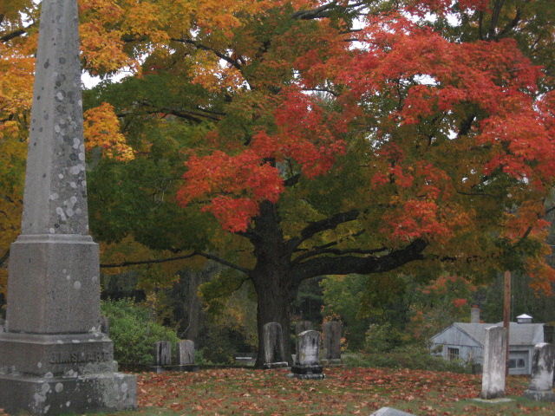
Any Questions?
Photo Credit: Cynthia Copeland

